Slide 1
CS315 – Project Two (Lambda Adventures)
{Ethan Buckner}
{ link to game source repo }

Slide 2
Milestone 1
By this point you should have completed:
Player movement and interaction {check part – Want more interactions with other npcs}
Level design and layout {check}
Collectibles {Not checked – I need to add some element to collect around the map}
One bit of interactivity {check – Movement and Collison detection has been added}

Slide 3
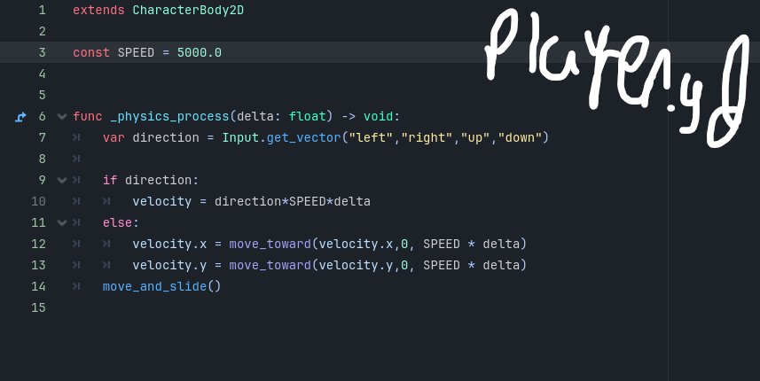
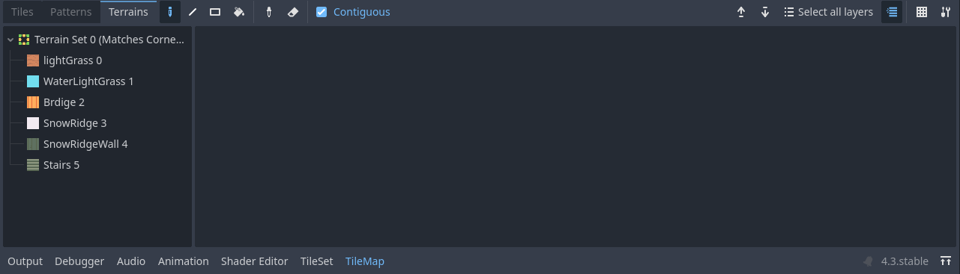
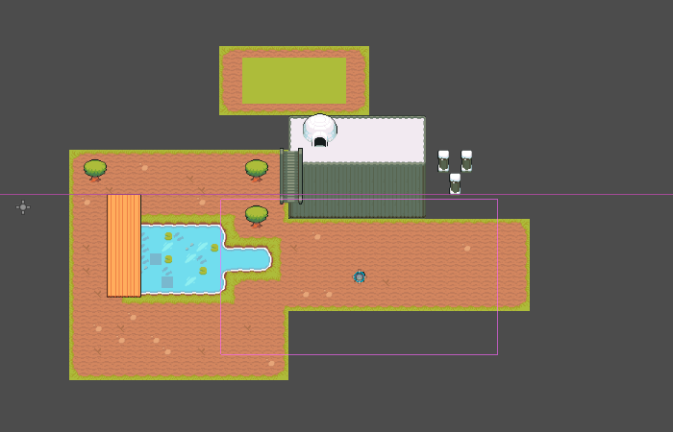
M1 – Screenshot / image
Add a screenshot of your project – code, current visual state, whatever
The Tiles are placed in two separate layers, one for decoration, and the other for groundwork

Slide 4
M1 – Question
Can we create one base npc and use that as a template for other NPCs we want to add into our game? Or do we need to create a whole new object for each now NPC?

Slide 5
M1 – Discussion
Delete this and add 2-3 takeaways from your discussion with your peer. Consider these elements:
The tile set was nice and has some instance or contrasting colors, however I might need to change it and create my own new one, so I have full legal representation of my project.
My player character doesn’t have an inventory system at all yet and so I need to implement that still as well as implement a clean looking way to view everything the player has in their inventory.
NPCs was a big topic we talked about today, We discussed how to create new NPCs and what the basic ‘template’ for them would be. Although we didn’t get very far, we came together and thought about one separate .gd script that we would attach to every npc instance or instantiate npc in general and then affix certain properties to it that way.

Slide 6
M1– Technique Reflection
Tile maps and sets are fun to create now, I mainly was working on getting the tile map to work properly and fix the border edges automatically so I don’t need to do a lot of getting and setting manually.
Character creation using Input.getVector was interesting and was similar to how we got direction from the player in the last game we created, and I think I understand how the direction variable works now.

Slide 7
Milestone 2
By the point you should have completed:
Doors / collectibles finished (Just started)
User interface (Check)
Enemies added (Obstacles but not NPCs yet)
Some “juice” (Check, over arching story and interactions are UNIQUE)

Slide 8
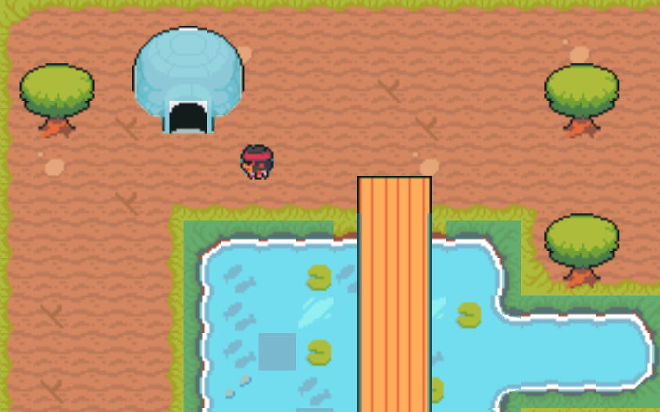
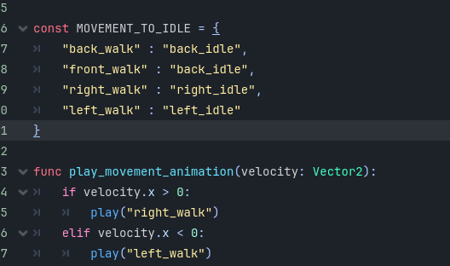
M2 – Screenshot / Image
Add a screenshot(s) of your project

Slide 9
M2 - Question
How do we add saved games in godot?
Do we export them as a text file or as a godot file?
https://docs.godotengine.org/en/stable/tutorials/io/saving_games.html

Slide 10
M2 - Discussion
Discuss these elements of your game
The difference between the colors outside, the white snow contracts against the green grass outside in the town. The building interiors also contrast the rest of the world, as well as the UI!
Pattern / rhythm in gameplay (think visual and temporal)
The layout of the town is simple and easy to manuvour around. The small lakes add good contrast on what you can walk on and the animations are smooth, not in beat, but have some rhythm the background music goes with!
Code layout and structure
The layout for the code is the same as any other project, at the beginning of the godot file put variables and/or onready functions, and then the rest of the code after that. The structure of the project is a little bare bones right now, however I have movement done, and just need an inventory system worked out.
Messaging between elements
OOP gets in our way when we want to change the different parameters of the objects in our game scene.

Slide 11
M2 Reflection
I’m struggling with time management and how to separate everything I have left to do into manageable chunks of code. I’m also struggling on what the main ‘mechanic’ of the game will be.
Creating a mood board is something that I feel like might help me come up with some more ideas to stew on.
I like the idea of an inventory system, and having the ability to duel wield any item in both hands. I love the overarching story of an ‘easy’ semester in a small college town.

Slide 12
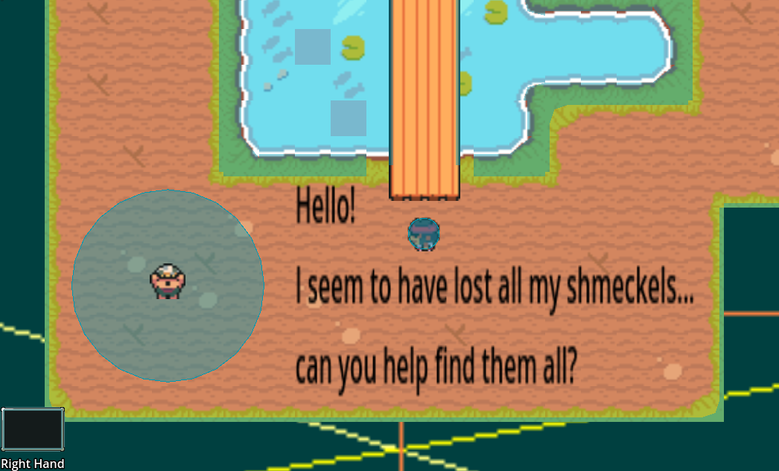
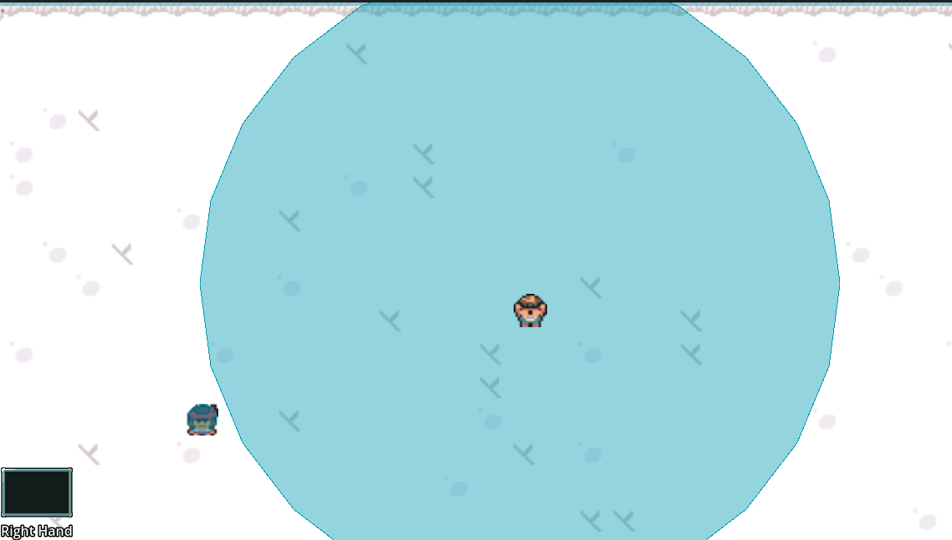
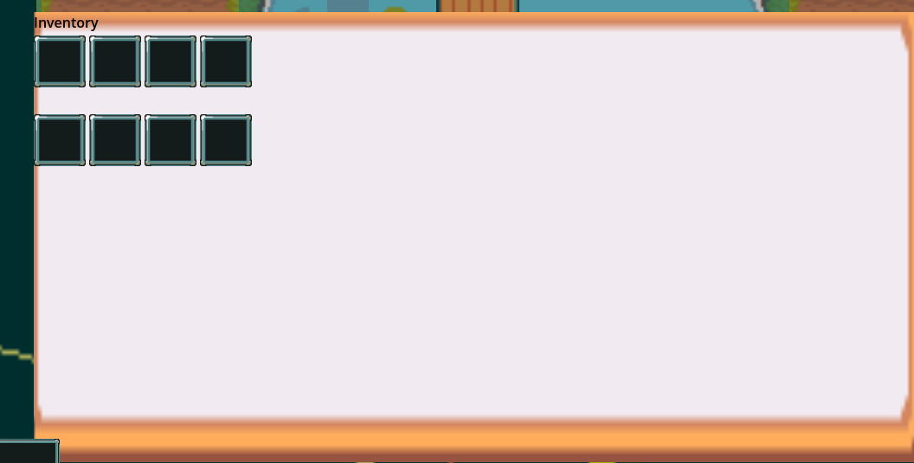
P2 – Final Reflection
Screenshot of final product here

Slide 13
P2 – Final Reflection
I really liked this project and had a lot of fun with it!
Every error that I was thrown I was able to overcome with both help from my peers and from external sources like Youtube!
The most challenging part of this project was the inventory system that I crafted and dealing with overflow into other inventory spots. The second most challenging portion of this assignment was working with tile maps and how confusion the different layers can get if you aren’t careful.
My brain also feels like mush now ☹

